Slide 1
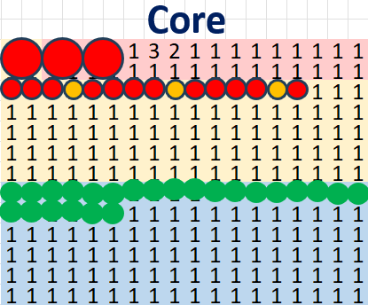

Object Assignment
Serious Injuries – Large Dots
Map is divided into 3x sections:
Injuries are (small dots), red is needed First Aid, amber is did not required First Aid)
With LTI which means needed the absence(Large Dots)
Green dots area, for observations
Minor and Middle injuries. Small red or amber dots
Observations – Green dots
Number of cells determine maximum capacity of objects to be assigned. If more that number of cells, then code should stop generating values

